Slide 1
Introduction to Arduino Workshop
Presented by: Sriram Boppana

Slide 2
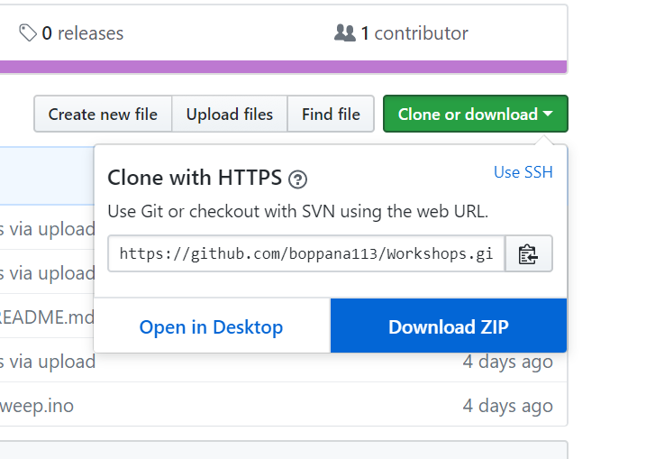
Before we begin
Follow this link and download the repository:
https://github.com/boppana113/Workshops
Open the powerpoint for this workshop
Download Arduino IDE if you have not already:
https://www.arduino.cc/en/Main/Software
If you do not have a computer, please let us know so we can provide you a computer with Arduino installed already

Slide 3
Agenda
Intro to Microcontrollers (~5 min)
Arduino Hardware Layout (~2 min)
Example Projects
Programming the Arduino:
Blink on-board LED
Blink external LED
Read Analog voltage and print to serial monitor
Control Servo Motor
Where can I learn more?
Where to buy an Arduino

Slide 4

What is a Microcontroller?
Microcontroller (MCU) is a user programmable digital computer
Contains a microprocessor (CPU)
Contains flash memory (ROM) and Random access memory (RAM)
Contains digital connections (Input/Output)
MCUs are dedicated to one task and run one specific program.

Slide 5
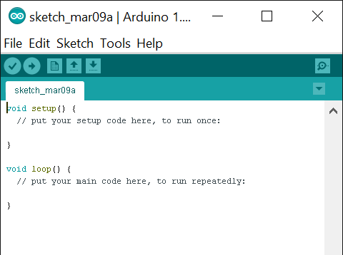
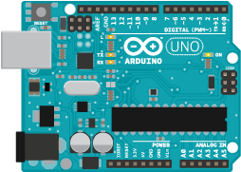
What is Arduino?
Arduino is an open-source platform used for building electronics projects.
Arduino consists of both a microcontroller and a piece of software, or IDE (Integrated Development Environment) that runs on your computer, used to write and upload computer code to the physical board.
Arduino IDE
Arduino Board
Write/Upload

Slide 6
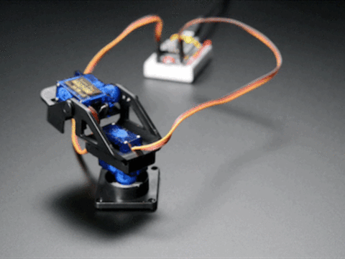
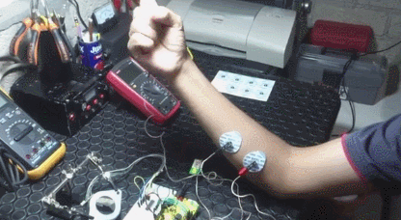
Examples – Moving Parts and Sensors
Servo Motors
EMG controlled clamps

Slide 7
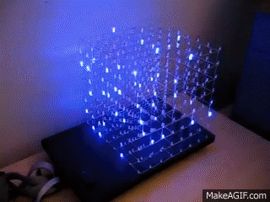
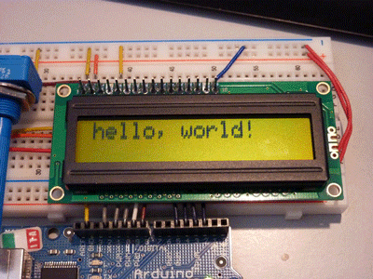
Example Blink and Display
LEDs (Light emitting diodes)
LCDs (Light crystal display)

Slide 8
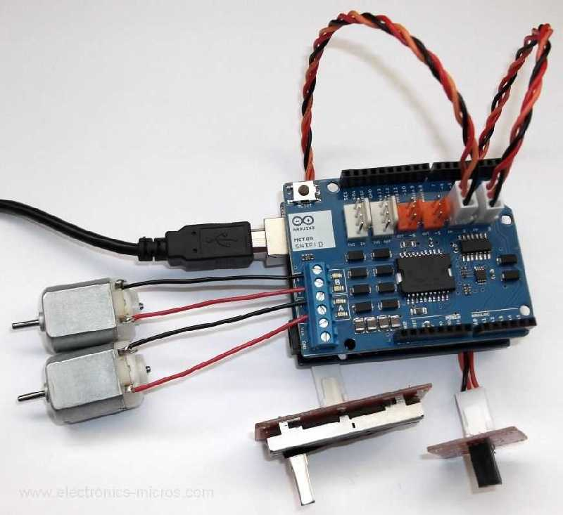
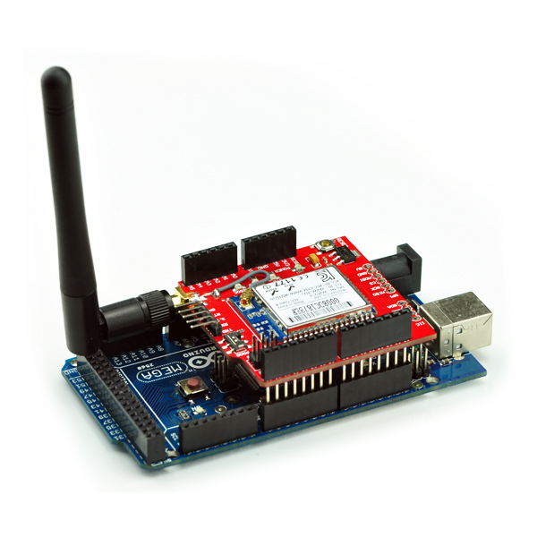
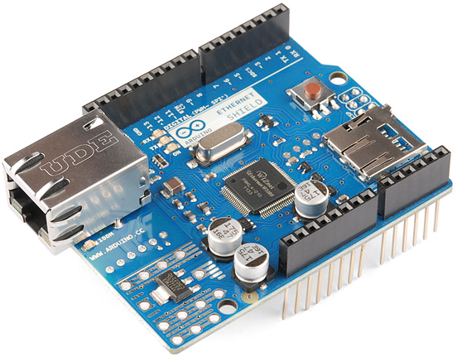
Arduino Shields
Ethernet
Motors
Radio

Slide 9
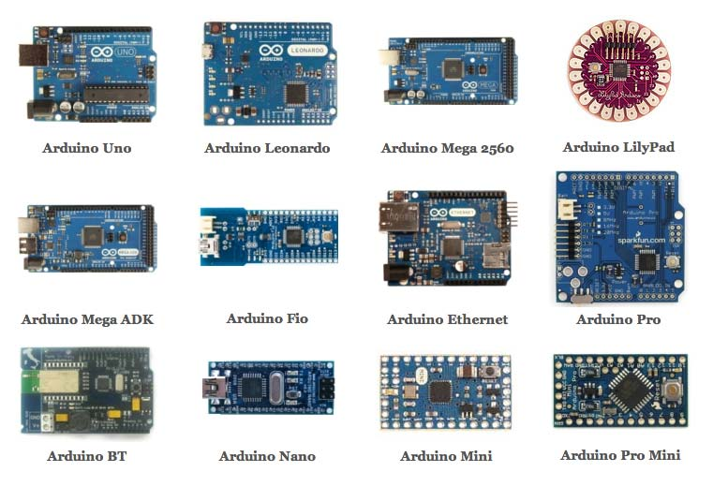
Types of Arduinos

Slide 10
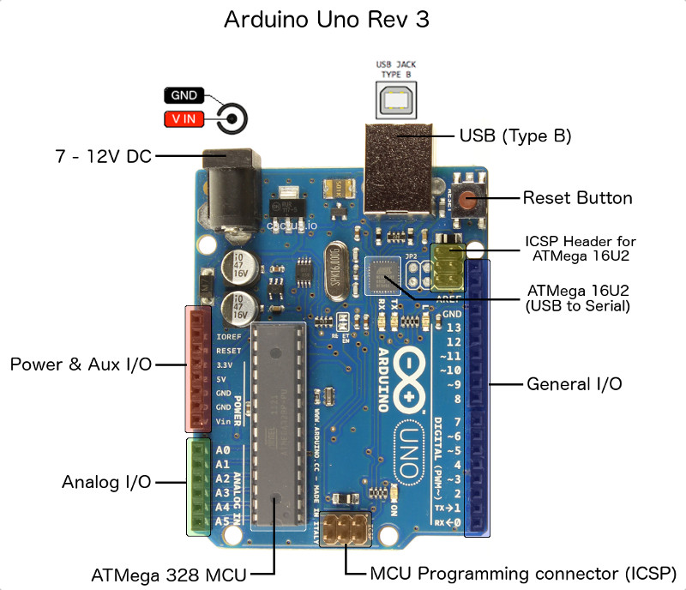
Arduino Uno Hardware Layout
Digital pins (Input/Output):
Digital sensors
Interface with sensors
Analog pins:
Measure voltage
Power Supply Pins:
5 V
3.3 V
GND

Slide 11
Blink on-board LED
LED

Slide 12
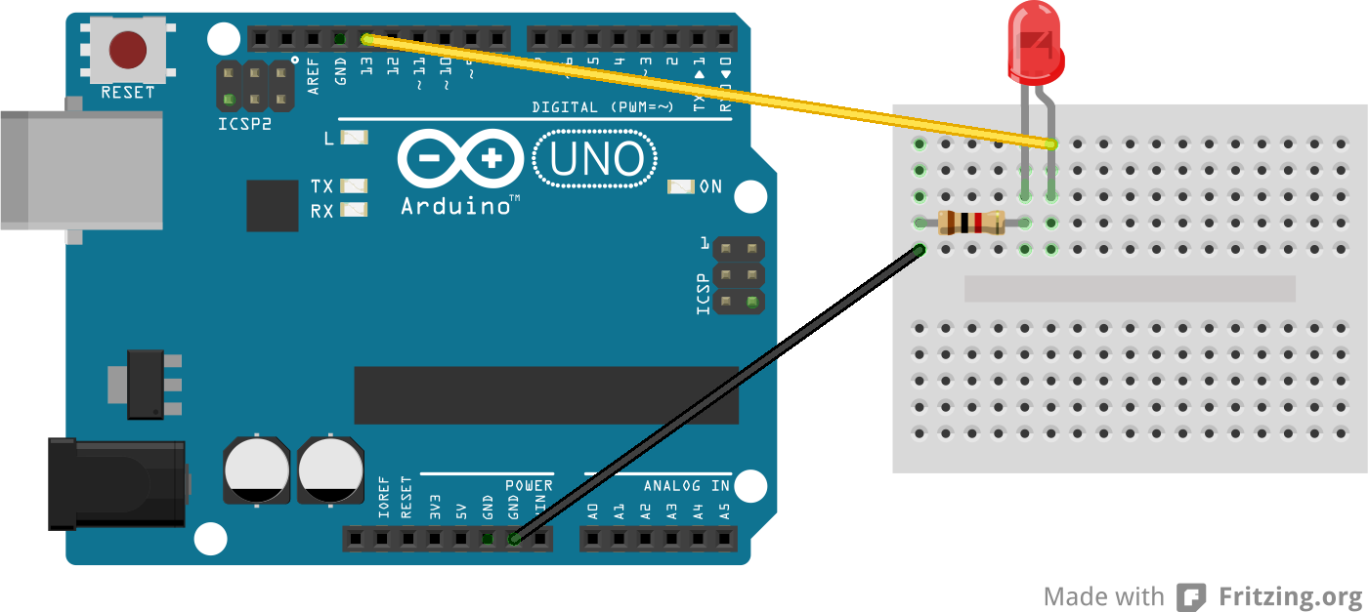
Blink external LED

Slide 13
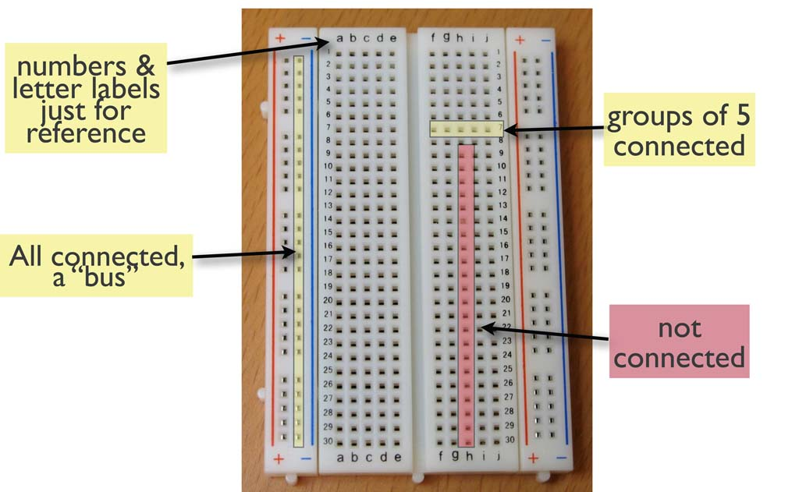
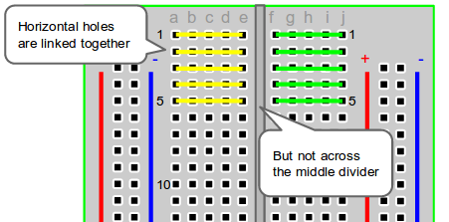
Breadboards

Slide 14
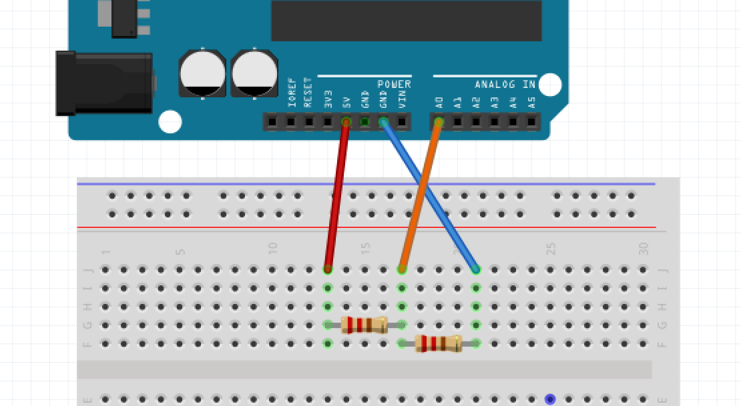
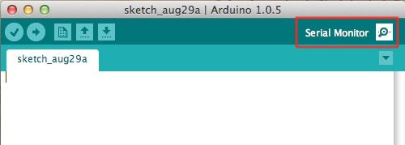
Read Analog Voltage/Read Serial Monitor

Slide 15
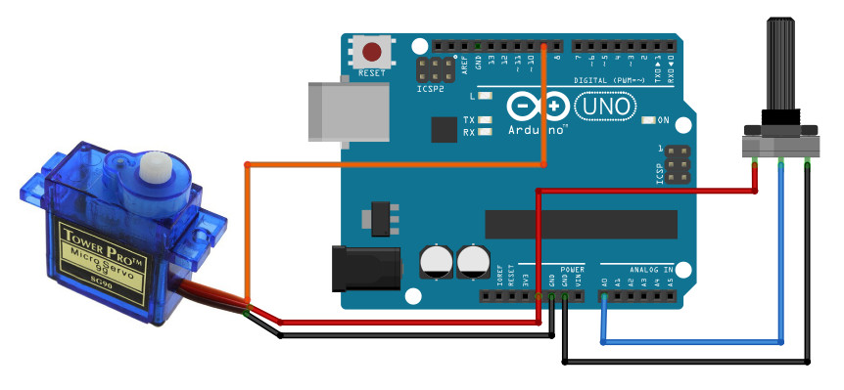
Arduino Servo Motor

Slide 16
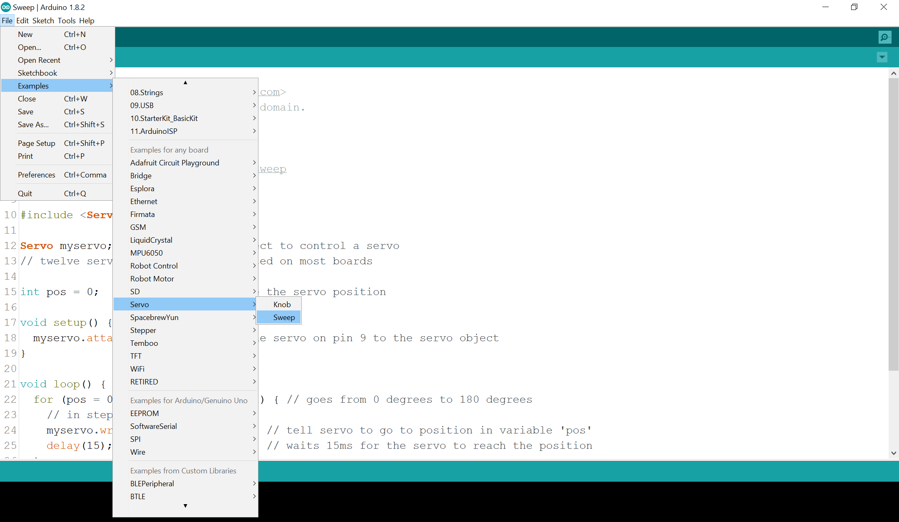

Slide 17
Where can I learn more?
Main Arduino website
Tutorials: https://www.arduino.cc/en/Tutorial/HomePage
Projects: https://create.arduino.cc/projecthub
Sparkfun tutorials:
https://goo.gl/rMVK49
Instructables Arduino class:
https://www.instructables.com/class/Arduino-Class/

Slide 18
Buy your own Arduino
3rd floor of thinkbox by front desk
Adafruit starter kit:
https://www.adafruit.com/product/68
Amazon:
https://www.amazon.com/s/ref=nb_sb_noss_1?url=search-alias%3Daps&field-keywords=arduino
Note:
Because Arduino is open-source, there are many knockoff versions of Arduino microcontrollers. Be wary of knockoff Arduino’s compatibility with your computer’s operating system

